Slide 1

THE WEEKLY PLAN
IAN TURNER

Slide 2
THE weekly plan age groupers
 | AM | PM
Monday | Zone 2 Aerobic Maintenance | Zone 3/4 High Heart Rate
Tuesday | Rest and Recover | Zone 5 Speed Development
Wednesday | Zone 2 Aerobic Maintenance | Zone 2 Threshold
Thursday | Zone 3 Specific Over Distance | Zone 3/4 High Heart Rate
Friday | Zone 2 Aerobic Maintenance | Zone 2 Preparation for 200 Speed
Saturday | Zone 4 200 Speed Work | Rest and Recover
Sunday | Rest and Recover
Identify where you expect to make a gain!

Slide 3
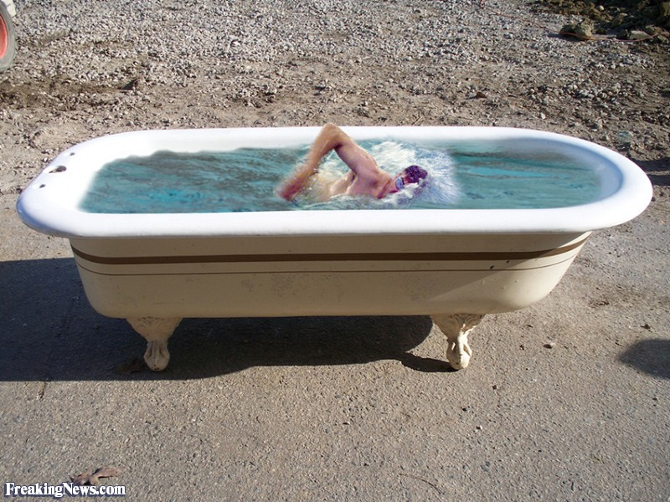

Slide 4
The weekly plan seniors
 | AM | PM
Monday | Zone 2 | Zone 3
Tuesday | Zone 1 | Zone 4/5
Wednesday | Zone 1/2 | Rest and Recovery
Thursday | Zone 3/4 | Zone 5
Friday | Zone 2 | Zone 2
Saturday | Zone 5 | Rest and Recovery
Sunday | Rest and Recovery
Any strength and conditioning work must revolve around the weekly plan.
But Sprinters are different!

Slide 5


Slide 6


