Slide 1
DESIGNING A WORKOUT
25 TIPS TO HELP YOU
IAN TURNER

Slide 2


Slide 3
This is a huge responsibility
Main set has to hit the desired energy system
Minimise the number of ‘lost’ sessions
Always be honest ,‘How many workouts are lost?’
Did the swimmers make a gain?’

Slide 4


Slide 5
Start writing the workout with the end in mind! What do you want to achieve?
What energy system do you want the swimmers to work in during the main set?
This energy system becomes the aim of the workout.
Write the aim of the workout on the top of session plan.

Slide 6
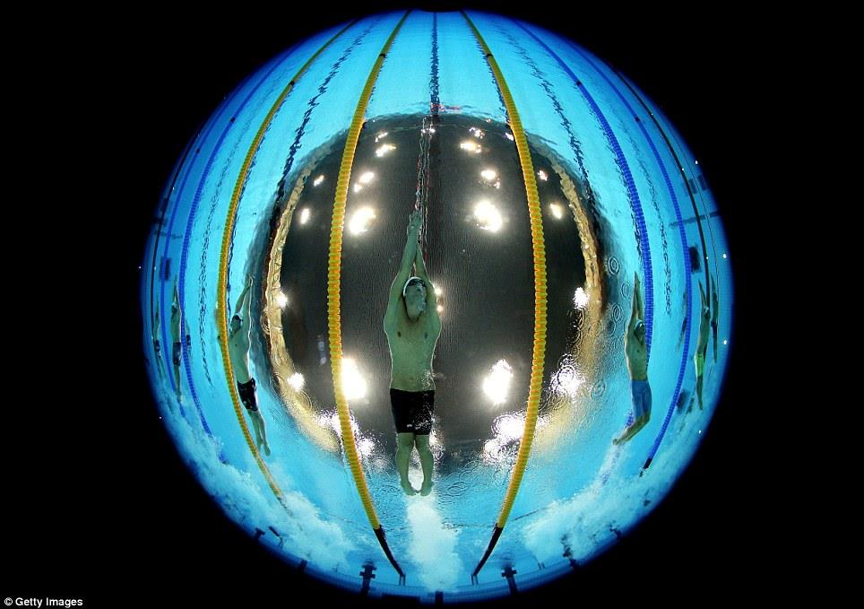

Slide 7
What is the duration of the workout? 1.5 hours/2 hours
How many metres do you hope to cover in the main set? Working in one energy system will require a shorter/longer set.
How many metres do you hope to achieve in the session? Age groupers who are training 6 times a week, 2.5 – 2.8k per hour? 5.5k in 2 hours? Seniors 3.5k per hour? 7k in 2 hours?
Record attendance and volume achieved – essential when talking to parents!!

Slide 8


Slide 9
Age groupers - approx. 40% of the workout done on freestyle. 40% on IM and 20% on No 1. How these % are delivered forms the basis of the workout design.
How long is the warm up? (20% of the total ?) Is there an element of skill? Short sprints?
Start every workout from a quality dive.
Preparation set prior to main set – lifts HR.
What part practices/drills (skill acquisition) are you including?

Slide 10
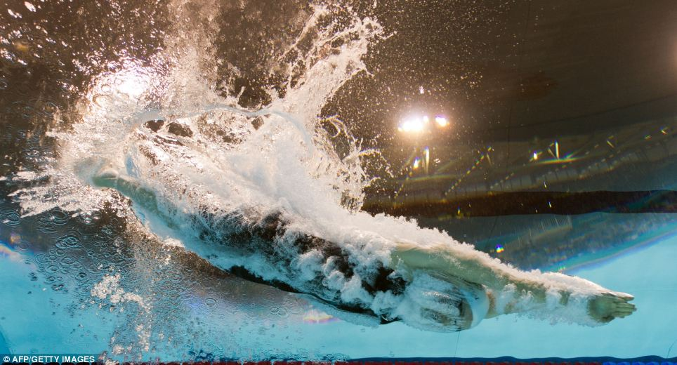

Slide 11
How much kick? 20% of total volume? 50% of this done as dolphin kick on back? Fins? Core strength – do you know what it is?
What stroke tips will you be passing on?
How long is the swim down? What will the content be? Recovery.
Don’t avoid coaching the strokes your not good at!!!!

Slide 12
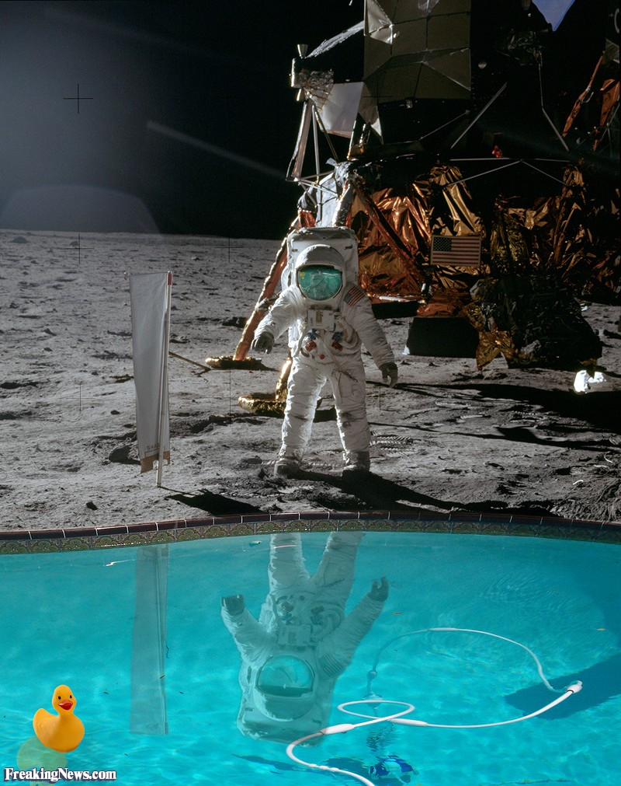

Slide 13
Review your workout prior to delivering it! I often change. Don’t hesitate to change things if its not going well.
A good workout is worth repeating on another occasion.
Keep a log book.
Build a portfolio of good sets – ‘borrow sets’

Slide 14
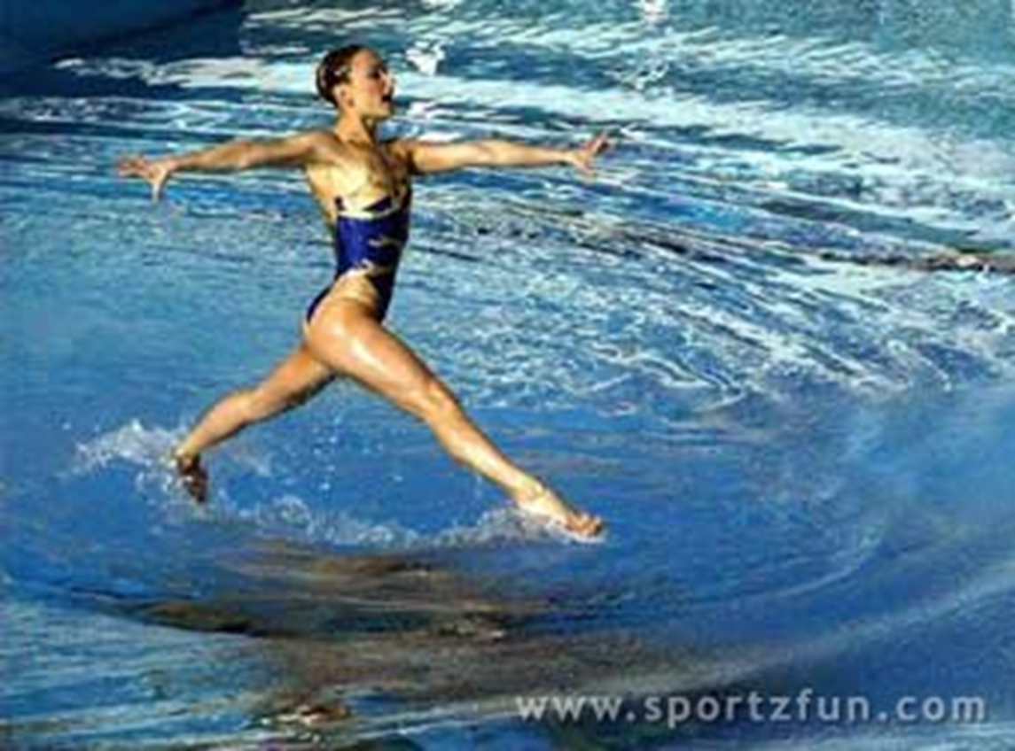

Slide 15
Ask for your workout to be watched and accept feedback.
Build confidence in your ability
‘Time spent on producing quality workouts is never wasted. Always remember, near enough is not good enough!”

Slide 16
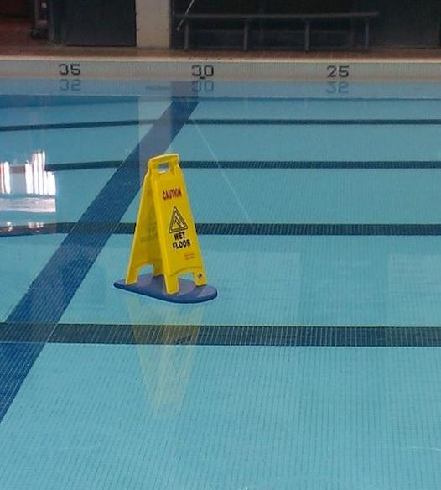

Slide 17


